Slide 1

Dhaka University Of Engineering & Technology, Gazipur.
Department of Computer Science and Engineering
Course No : CSE-3622
Course Title : Information System Analysis & Design Sessional
Project Name: Online Marriage Registration System
Team Name: DUET_IP
Presented To
1.Dr. Momotaz Begum
Associate Professor
CSE,DUET
2.Mr. Antu Saha
Lecturer
CSE,DUET

Slide 2


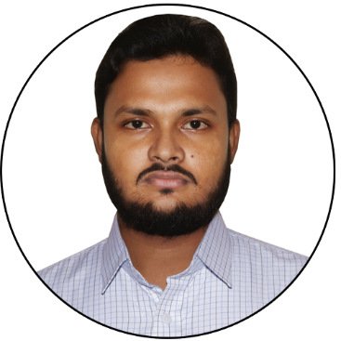



A Presentation on Online Marriage Registration System
Team Name: DUET_IP
Team Members
Md.Omar Faruq (164116)
Md.Nasir Uddin (164106)
Md.Harun-Ar-Rashid (164091)
Aposh kumar pk (164090)
Shaon Sarker (164097)
Md.Arif Hossain (164094)

Slide 3
Presentation outline
Candidate System Design
Select Best Candidate System.

Slide 4
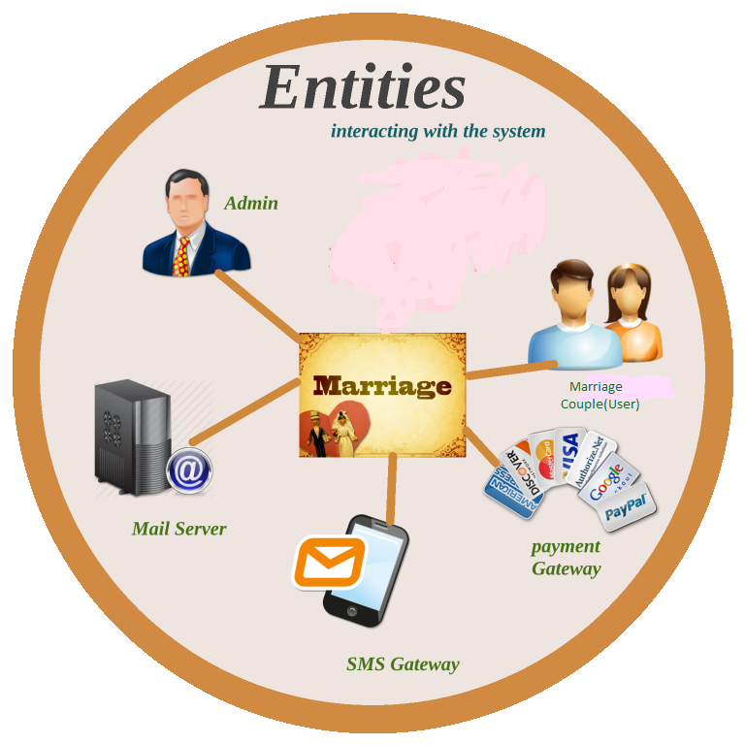
Candidate System 1.

Slide 5

How to the user uses this system?
Register
Log In
Fill up The marriage Registration form
Upload the form
Download Marriage Certificate
Marriage Couple(User)

Slide 6

What is Admin task here?
Log In
View and verify Application details
Generate marriage certificate
Record save
Add/update/delete details
Maintain system and take responsibility

Slide 8
Tools and Technology used for Development:
C++ or Java or C# or Python
MySQL or Oracle
HTML, CSS or JavaScript
NetBeans
Draw.IO, Visio, Microsoft project, NCLASS
Android Studio
SQL lite
Domain and hosting

Slide 9
Cost Analysis:
Fixed Cost:
Serial No. | Name | Amount
1 | Web hosting | 700 $ (yearly)
2 | Domain | 15 $ (yearly)
3 | Software development cost | 50,000 $
4 | Website development cost | 6000 $
5 | Android development cost | 10,000 $
6 | Training cost | 30,000 $
 | Total Cost | = 96715$
Variable Cost:
Serial No. | Name | Amount
1 | Maintenance | 10 $ per day
2 | Updated cost | 20 $ per day

Slide 10
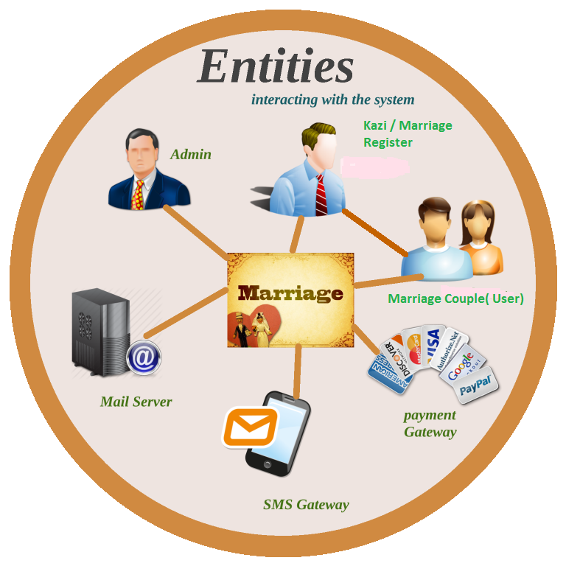
Candidate System 2:

Slide 11

How to the Kazi/marriage register uses this system?
Log In
Collect information from user
Submit all the information in the system
Feedback receive
Kazi / Marriage Register

Slide 12
What is Admin task here?
Log In
View and verify Application details
Generate marriage certificate
Record form details
Add/update/delete details
Maintain system and take responsibility
Create an account for user

Slide 13
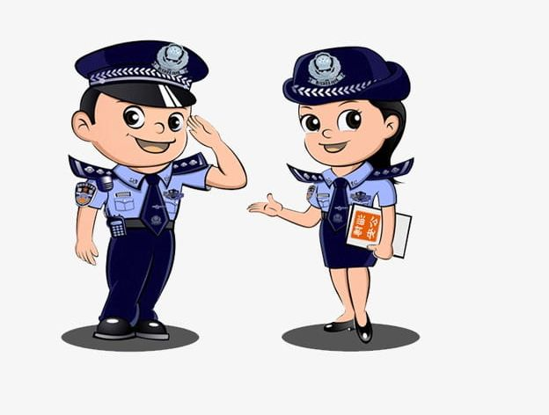
Log In
Download Marriage Registration certificate
Marriage couple(user)
Collect Registration number from user
Check or Collect data form website through Registration number
Police
Passport/Visa officer//Magistrate

Slide 14
Tools and Technology used for Development:
C++ or Java or C# or Python
MySQL or Oracle
HTML, CSS or JavaScript
NetBeans
Draw.IO, Visio, Microsoft project, NCLASS
Android Studio
SQL lite
Domain and hosting

Slide 15
Cost Analysis:
Fixed Cost:
Serial No. | Name | Amount
1 | Web hosting | 700 $ (yearly)
2 | Domain | 15 $ (yearly)
3 | Software development cost | 50,000 $
4 | Website development cost | 6000 $
5 | Android development cost | 10,000 $
6 | Training cost | 30,000 $
 | Total Cost | = 96715$
Variable Cost:
Serial No. | Name | Amount
1 | Maintenance | 10 $ per day
2 | Updated cost | 20 $ per day

Slide 16
Selecting best candidate system
We select system 2 as a best candidate system.

Slide 17

Why system 2 is best?
Admin
User
System 1

Slide 18

Marriage Couple(User)
Admin
System 2
Kazi/Marriage Register

Slide 19


